Slide 1




Medical Abortion at all Gestations
Professor Emeritus Allan Templeton, University of Aberdeen

Slide 2


Slide 3


Slide 4
EBCOG Statement
The provision of safe abortion is crucial to the public health of all communities.
WHO advises that the choice of abortion should be readily available to women in all national healthcare systems.
EBCOG considers that its universal availability in all countries in Europe is fundamental to women’s health and well-being.
Medical abortion is one of the safest procedures in medical practice, with minimal morbidity and mortality, and as such there appears to be no good reason to restrict the licensing of mifepristone and misoprostol.
EBCOG recommends that training in abortion care is mandatory and is included in the curriculum for anyone training in the specialty of gynaecology and obstetrics.

Slide 5
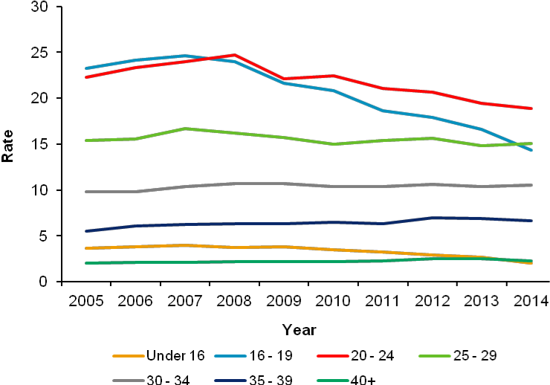
Rates of termination by age of woman 2005 – 2014

Slide 6
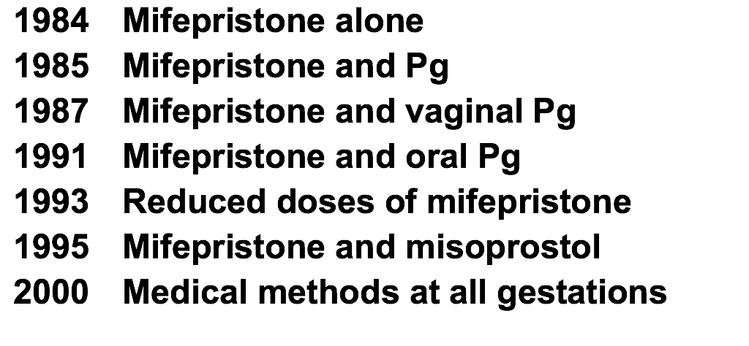
Development of medical methods of induced abortion with mifepristone and prostaglandin
1984 Mifepristone alone
1985 Mifepristone and Prostaglandin
1987 Mifepristone and vaginal prostaglandin
1991 Mifepristone and oral prostaglandin
1991 Reduced doses of mifepristone
1995 Mifepristone and vaginal misoprostol
2000 Medical methods at all gestations
2002 Mifepristone and sublingual misoprostol

Slide 7
Outcome of medical abortion (10291 women)
 | <7 | 8-9 | 10 | 11 | 12 | 13 | 14-15 | 16-17 | 18-19 | >19
Evac | 1.8 | 1.7 | 3.8 | 4.8 | 6.4 | 6.0 | 4.7 | 6.0 | 4.1 | 2.2
Incomp | 1.3 | 1.1 | 2.6 | 2.7 | 3.2 | 2.5 | 3.5 | 3.9 | 3.0 | 1.5
FH | 0 | 0.2 | 0.7 | 1.8 | 2.8 | 2.7 | 0 | 0.3 | 0.0 | 0.0
Emerg | 0.5 | 0.4 | 0.5 | 0.3 | 0.4 | 0.8 | 1.2 | 1.8 | 1.1 | 0.7

Slide 8
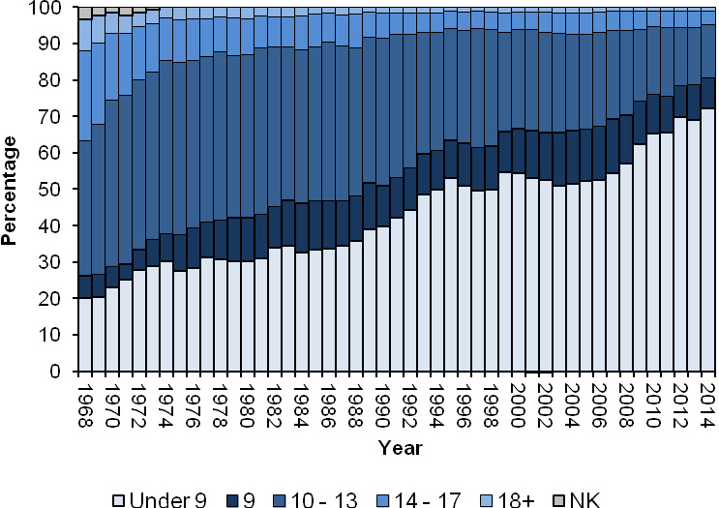
Abortions in Scotland by Gestation 1968-2014

Slide 9
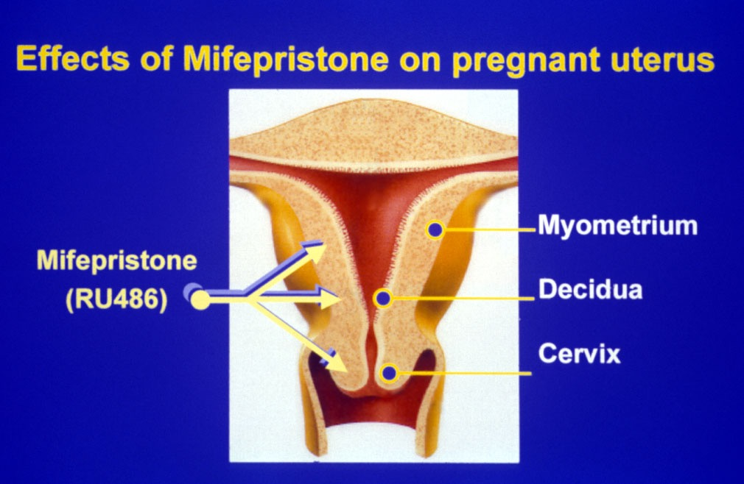

Slide 10
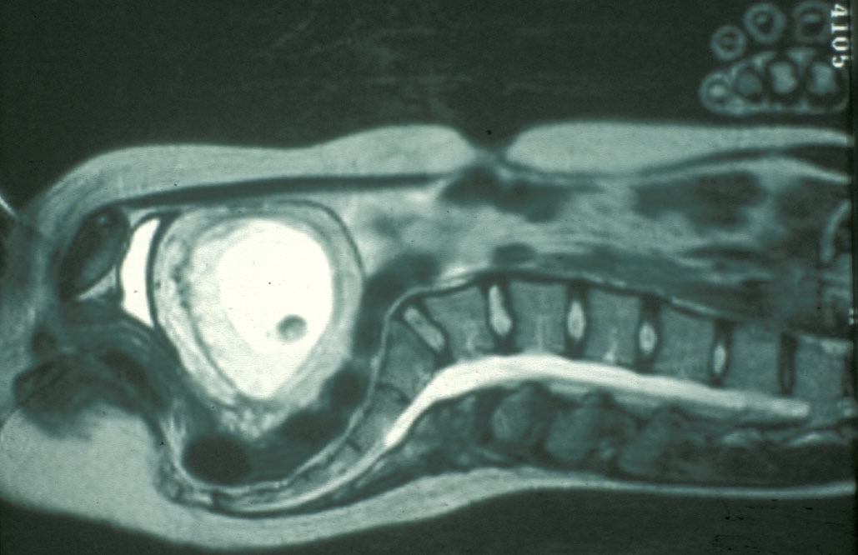
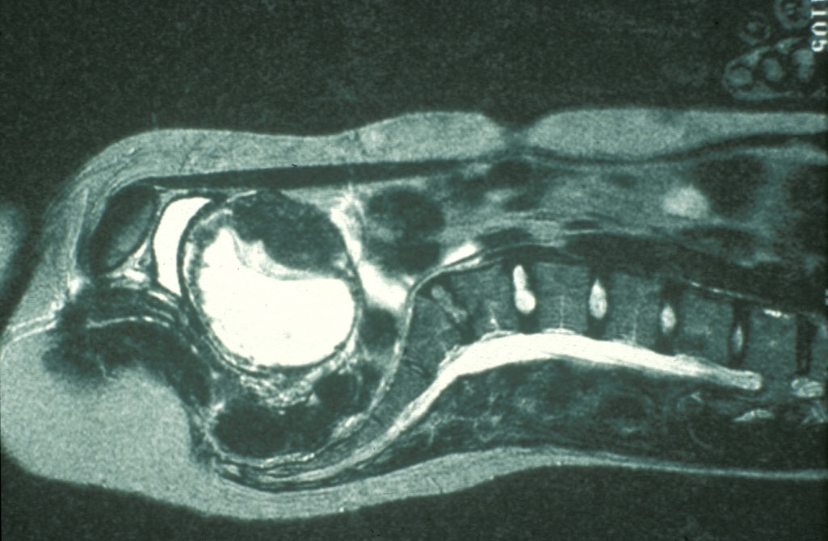

Slide 11
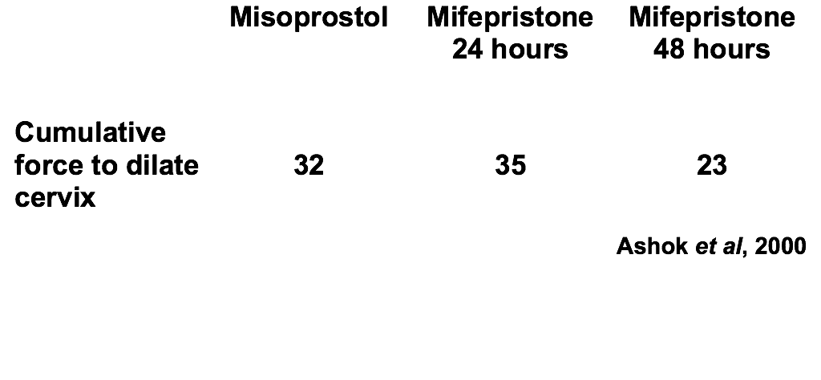
Comparison of mifepristone and misoprostol

Slide 12
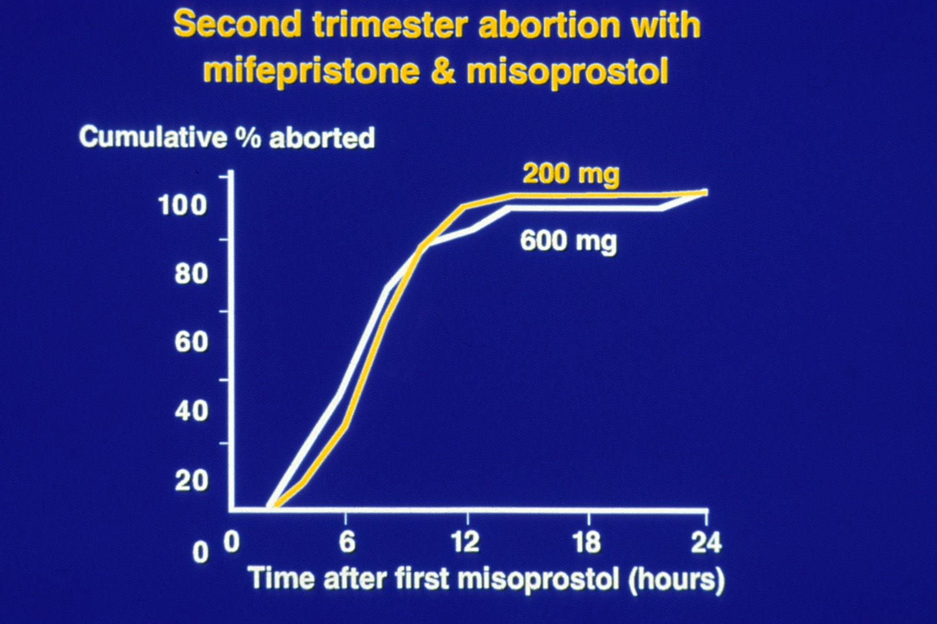

Slide 13
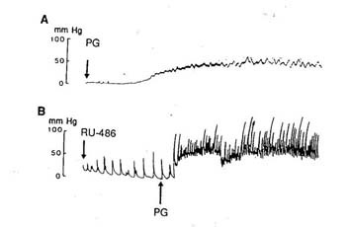
Mifepristone, PG and uterine contractility
Bygdeman & Swahn 1985

Slide 14
Uterine contractility* in response to PGE2 in 20 women treated with RU486
 | PG Dose
 | Control | 0.05 | 0.1 | 0.15
Control | 6 | 49 | 45 | 122
24 hours | 50 | 300 | 356 | 529
36 hours | 222 | 711 | 806 | 1023
48 hours | 175 | 502 | 636 | 910
*Montevideo units
Swahn and Bygdeman, 1988

Slide 15
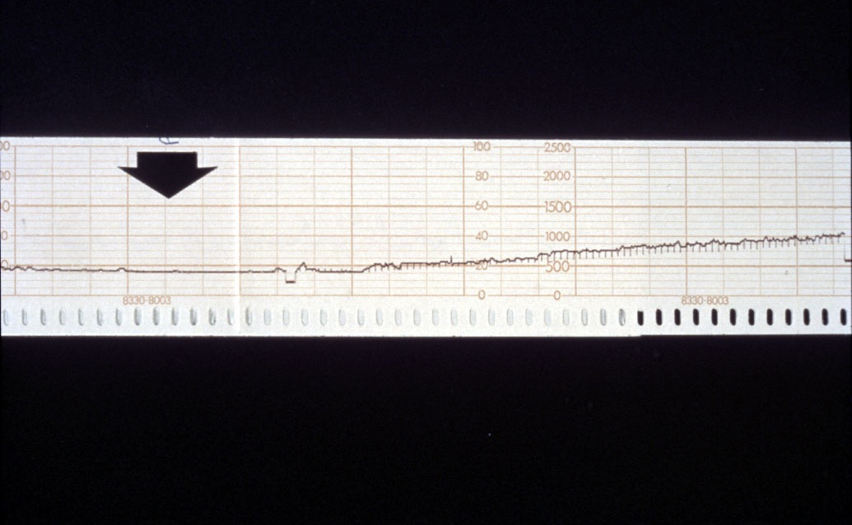
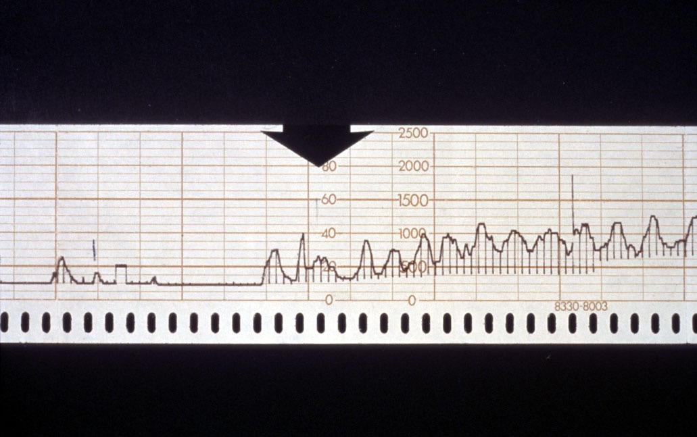

Slide 16
Misoprostol alone
Higher total dose is needed
Less effective (failed and continuing)
Induction-to-abortion interval longer
80-90% within 24 hours
More side-effects.
Gemzell-Danielsson and Lalitkumar, 2008

Slide 17
Cervical Preparation with misoprostol before Surgery reduces incomplete abortion
Misoprostol Placebo RR(CI)
n=2427 n=2431
Complications (%) 2 4 0.7(0.5-0.96)
Incomplete Ab (n) 19 55 0.3(0.2-0.6)
Meirik et al 2012

Slide 18
Early Medical Abortion using
mifepristone 200mg then vaginal misoprostol 800ugs
 | <49 Days n = 2879 (46%) |  | 49 – 63 Days n = 3396 (54%)
 | n | % | n | %
Evacuations | 51 | 1.8 | 81 | 2.4
Missed/Incomplete | 40 | 1.4 | 51 | 1.5
FH Present | 2 | 0.1 | 13 | 0.4
Emergency | 6 | 0.2 | 13 | 0.4

Slide 19
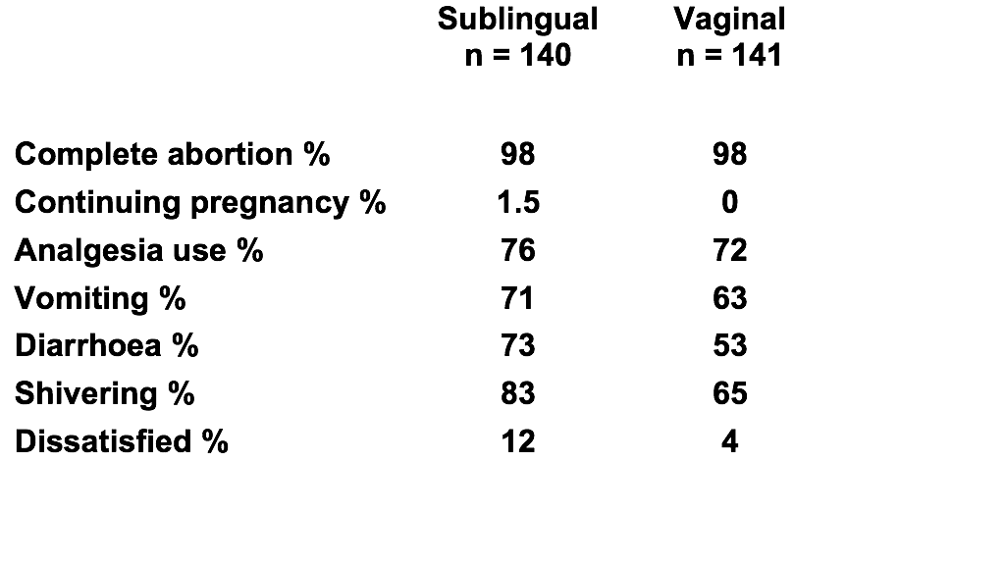
Sublingual misoprostol as effective as vaginal but with slightly more side effects (for medical abortion up to 13 weeks)
Hamoda et al, 2004

Slide 20
Outcome of medical abortion at home
among 1001 women
 | n (%)
Complete | 993 (99.2)
Missed / incomplete | 6 (0.6)
FH present | _
Emergency | 2 (0.2)

Slide 21
Abortions at Home, Aberdeen 2003-2015

Slide 22
Late First Trimester Medical Abortion in 2228 Women
Gestation in Days | 64 – 70 (n=1037) | 71 – 77 (n=584) | 78 – 84 (n=389) | 85-91 (n=209)
Evacuation | 3.2 | 5.1 | 7.5 | 6.7
( Missed/Incomplete | 2.2 | 3.1 | 4.2 | 3.8
FH Present | 0.7 | 1.7 | 2.6 | 2.9
Emergency | 0.3 | 0.3 | 0.8 | 1.0 )

Slide 23
Outcome among 10-13 weeks since change
 | Review % | Change %
Complete | 95.0 | 97.3
Missed/Incomplete | 2.8 | 1.3
FH present | 1.7 | 1.3
Emergency | 0.5 | 0

Slide 24
Second trimester regimen
Mifepristone 200 mgs
36 – 48 hours later
Misoprostol 0.8 mgs vaginal (sublingual)
Then according to bleeding
Misoprostol 0.4 mgs vaginal/sublingual/oral
Up to a total of 5 doses (15 hours)

Slide 25
Doses of PG used in second trimester
Surg evac (%) 2.3 2.7 5.9 17.1 23.1

Slide 26
Second trimester medical abortion (n=1002)
 | Cumulative success
 | No. | %
Day 1 | 970 | 97.1
Day 2 | 989 | 99.0
Day 3 | 999 | 99.9

Slide 27
Second day
Repeat mifepristone 200 mgs evening
then repeat misoprostol regimen
If Third Day , no additional mifepristone
then gemeprost 1 mg , 5 doses

Slide 28
Second trimester recent (n = 1244)
Weeks | 13-14 | 14-15 | 15-17 | 17-19 | > 19
n | 383 | 236 | 282 | 219 | 124
Complete % | 98 | 92 | 95 | 95 | 98
Incomplete % | 1.0 | 6.3 | 3.5 | 3.6 | 1.6
Positive FH % | 0 | 0 | 0.4 | 0 | 0
Emergency % | 1.0 | 1.3 | 1.1 | 1.4 | 0.8

Slide 29
Women who would opt for same method
Weeks Medical Surgical
% %
<6 100 )
7 90 ) 87
8 69 )
9 66 )
10-13 70 79
13-20 53 100
From Henshaw 1993, Ashok 2002, Kelly 2010

Slide 30
Women approached but not randomised
67% had strong preference for surgical
wanting to be asleep
less traumatic psychologically
less painful
33% had strong preference for medical
not wanting to be asleep
shorter time to wait
Kelly et al, 2010

Slide 31
Analgesia use among 4343 women having medical abortion

Slide 32
Antibiotic Policy
All women are screened for chlamydia and gc
If positive given azithromycin (can use doxycycline)
If 18 years and under - given prophylactic azithromycin
All women get metronidazole 800mgs at time of abortion

Slide 33
Prevention of Subsequent Unintended Pregnancy
Immediate insertion of IUCD is safe and acceptable (Grimes et al 2003)
Significantly fewer subsequent abortions (Goodman et al 2008, Heikinheimo et al 2008, Roberts et al 2010)
Immediate insertion has higher rate of use at six months (Bednarek et al 2011)

Slide 34
First-trimester Abortion
• Up to 9 weeks’ gestation, a choice of medical or surgical abortion should be offered, since both are safe and effective. (Medical at home or surgical without GA but with misoprostol pre-treatment)
• Medical abortion is associated with more pain and bleeding, and it carries a slightly higher risk of incomplete abortion (2 to 5%, vs. 1% with surgical abortion).
• Surgical abortion may be associated with an increased risk of serious, but very rare, complications requiring major surgery.
• Women can be reassured that the current evidence indicates that neither method of abortion is associated with an increased risk of harm to their future reproductive health or to their future mental health, as compared with continued pregnancy.
• The insertion of an intrauterine device at the time of the abortion is the best reversible method of contraception to prevent another unintended pregnancy.

Slide 35
EBCOG Position Statement
The provision of safe abortion is crucial to the public health of all communities.
WHO advises that the choice of abortion should be readily available to women in all national healthcare systems.
EBCOG considers that its universal availability in all countries in Europe is fundamental to women’s health and well-being.
Medical abortion is one of the safest procedures in medical practice, with minimal morbidity and mortality, and as such there is no reason to restrict the licensing of mifepristone and misoprostol.
EBCOG recommends that training in abortion care is mandatory and is included in the curriculum for anyone training in the specialty of gynaecology and obstetrics.

